Slide 1
DEPARTMENT OF S PRAYAS CERTIFIED JAVA FULL STACK DEVELOPER
EDUBRIDGE INDIA PRIVATE LIMITTED 2021-2022
PRESENTATION FOR
“ COLLEGE WEBSITE”
SUBMITTED BY
MISS: D. ISHA
Batch No: EON-5755
Under The Guidance Of
Amruta Deore

Slide 2
ABSTRACT
This is the project for College Website. And in this website we added some webpages like Home, About Us, Contact Us, Admission Page ,Image Gallery, Departments, Register& Login page. and we will see about this pages in coming slides. This website is used to who would like to know about any college details and that’s specifications ,and where it’s placed all kind of this details, for this kind of information it’s very useful to know this details in anywhere If only the network is available.

Slide 3
INTRODUCTION
The objective of college website is to leaves a positive first impression with visitors , including current and prospective students, parents, faculty and staff, and any other seeking information.
The main purpose of this college website is to provide timely , engaging , and current information to our current students , parents & staffs . And attract new students.
We used different types of modules in this college website . Throughout this project our focus is presenting information in an easy and intelligible manner.

Slide 4
MODULES
Home Page
About Us Page
Departments page
Admission Page
Contact Us Page
Gallery Page
Registration Page
Login Page

Slide 5
SYSTEM REQUIREMENTS
SOFTWARE REQUIREMENT
Platform – Notepad++
2. Operating System -Windows10
3. Languages - Html & CSS ,Java Script

Slide 6
HOME PAGE
A home page is generally the primary web page a visitor navigating to a website from a search engine will see , and it may also serve as a landing page to attract visitors . Thus good home page design is usually a high priority for a website.

Slide 7
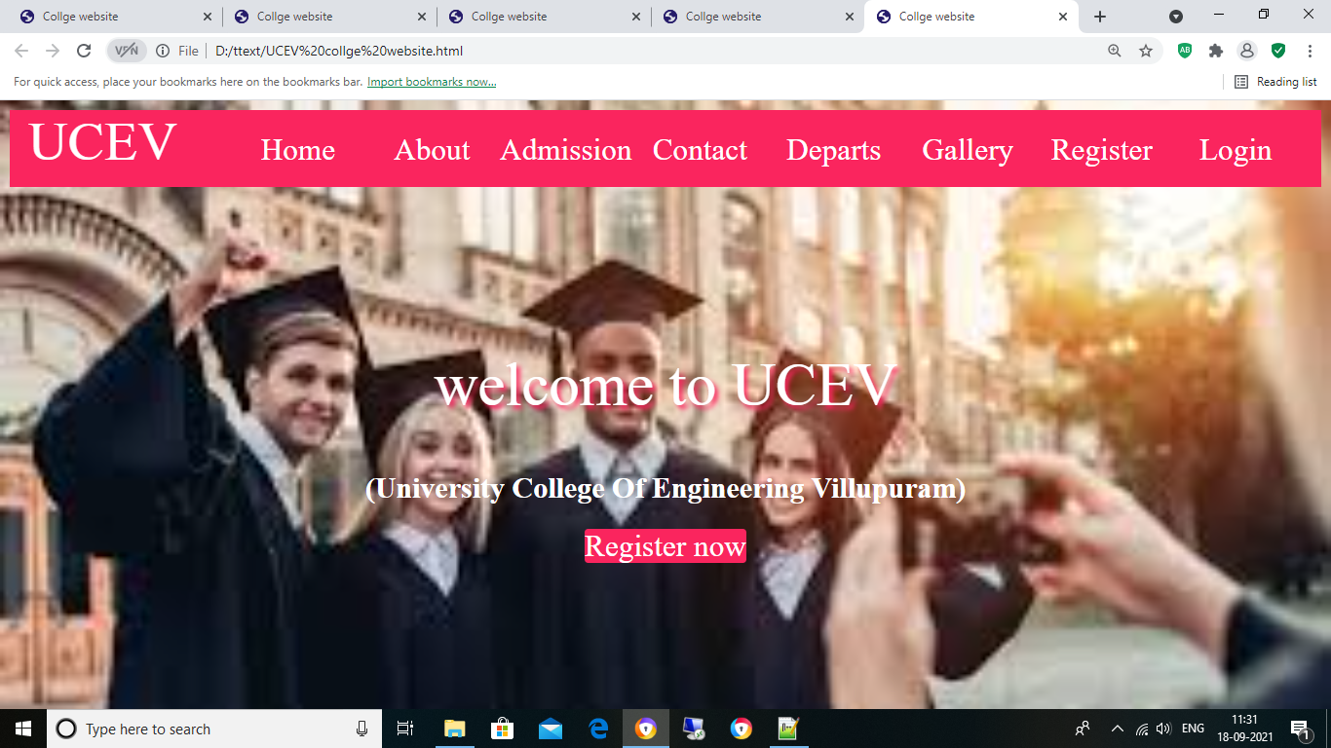

Slide 8
ABOUT US PAGE
The About Page is the section of a website where people go to find out about the website they’re on .
Readers will visit this section for many reasons and with various questions they want answered, but your objective is the same to inform them why they are on the site or why they should be on the site.

Slide 9
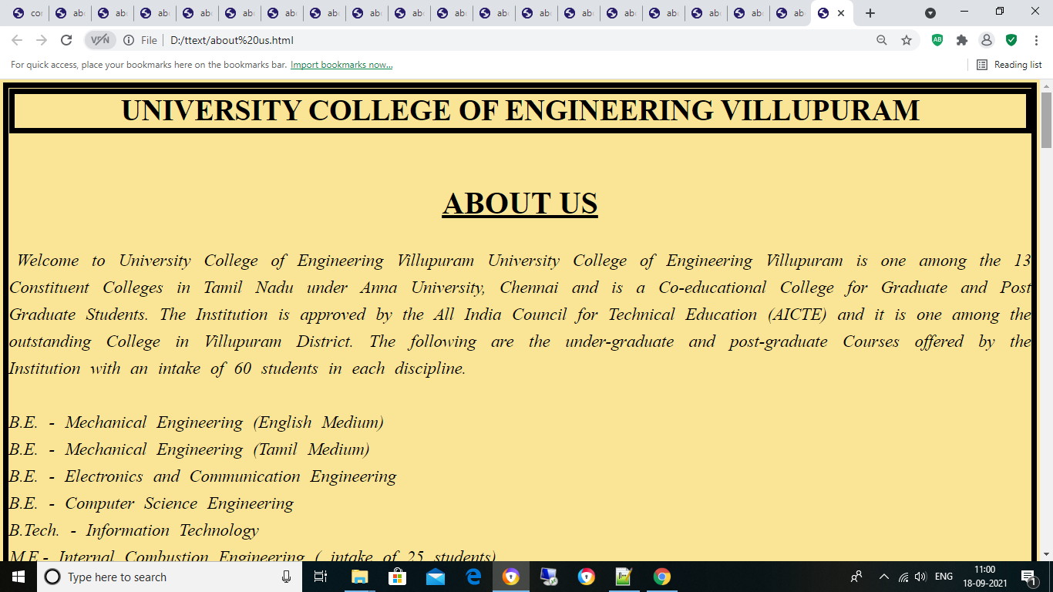

Slide 10
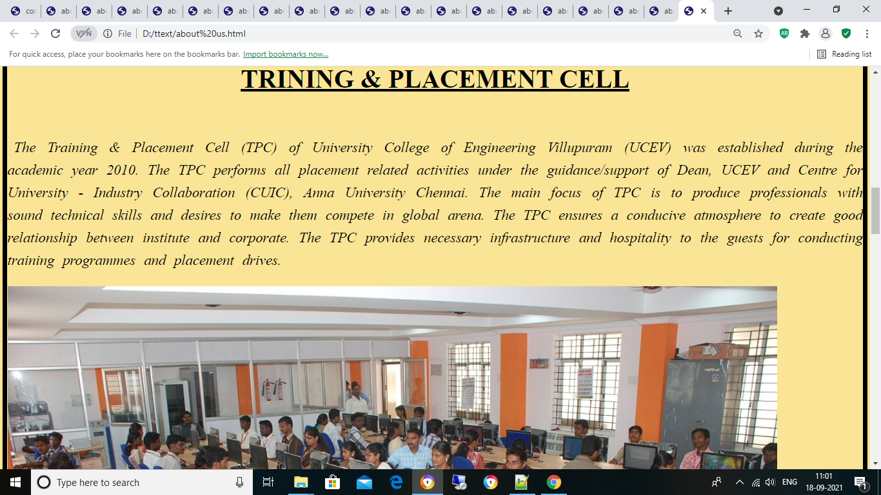

Slide 11
CONTACT US PAGE
A contact page is a common web page on a website for visitors to contact the organization or individual providing the website.
The page contains one or more of the following items:
E-mail address
Telephone number
Postal address
Sometimes accompanied with a map showing the location.

Slide 12
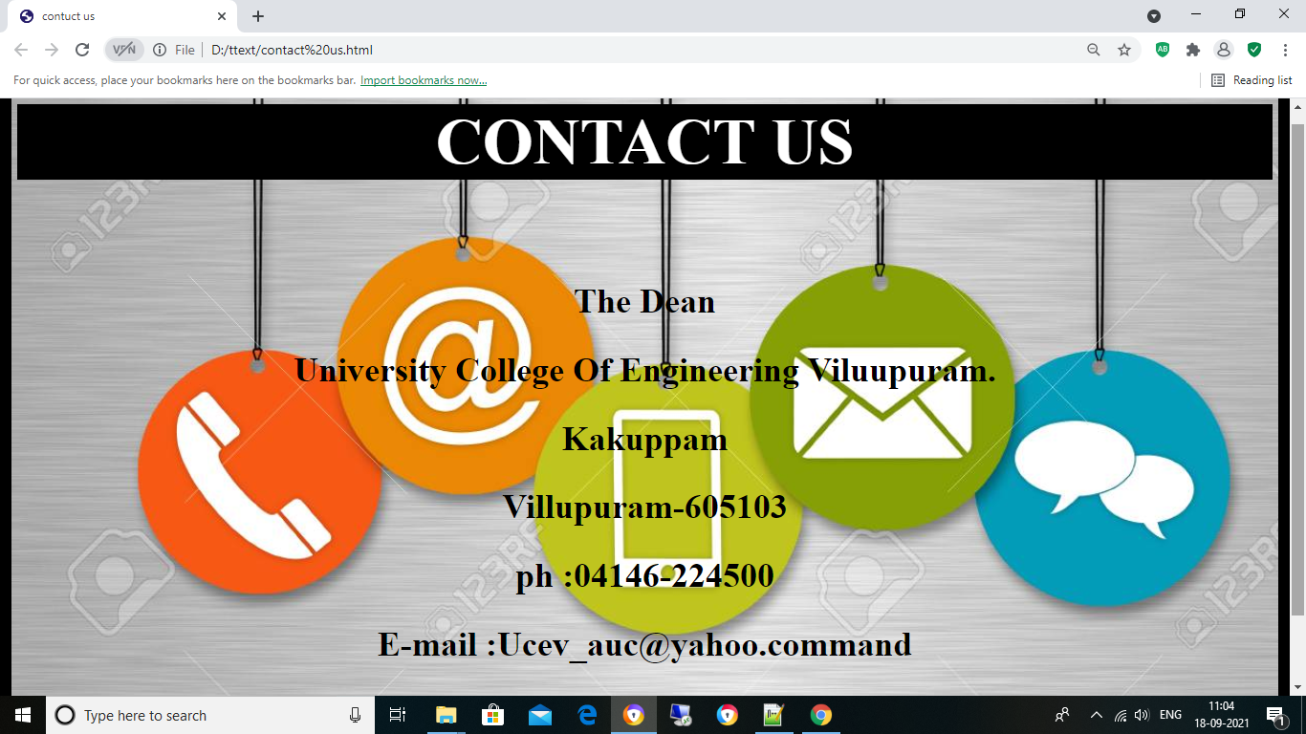

Slide 13
REGISTRATION PAGE
This module will help the students get registered from anywhere if only the internet is present.
This module will really simplify the task of on paper registration.
Also after successful registration the user can update information and change their password as and when required.

Slide 14
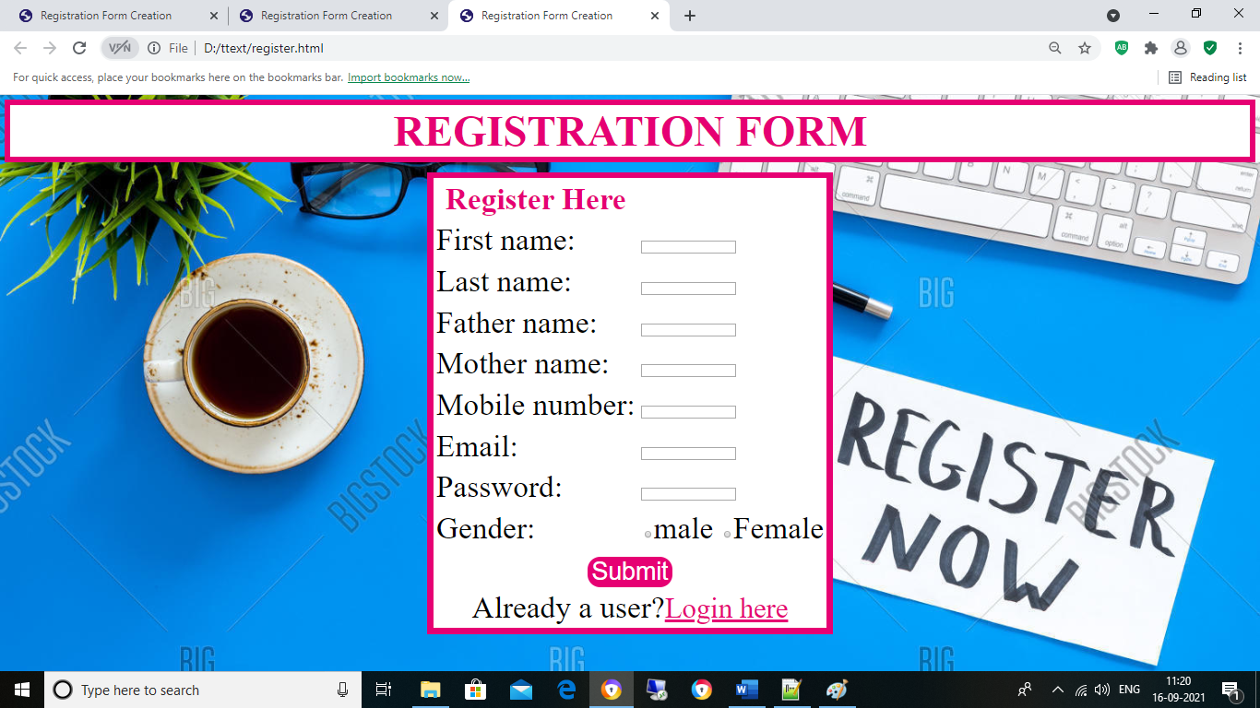

Slide 15
Login Page
Login module will help in authentication of user accounts.
Users who have valid login id and password can only login into their respective accounts.

Slide 16
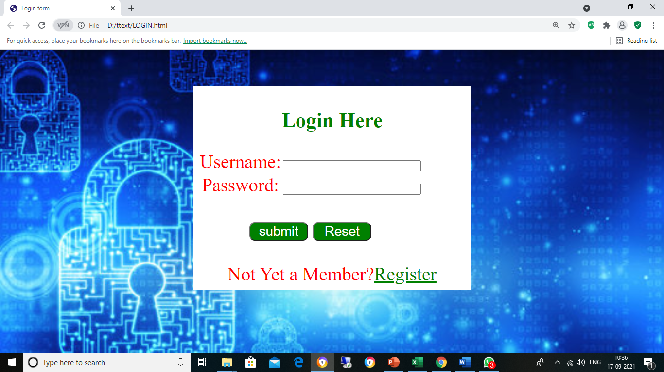

Slide 17
DEPARTMENTS PAGE
This page is used to who is searching our website it is very useful to know how many departments we have in our college. So they are easily select which department they want.

Slide 18
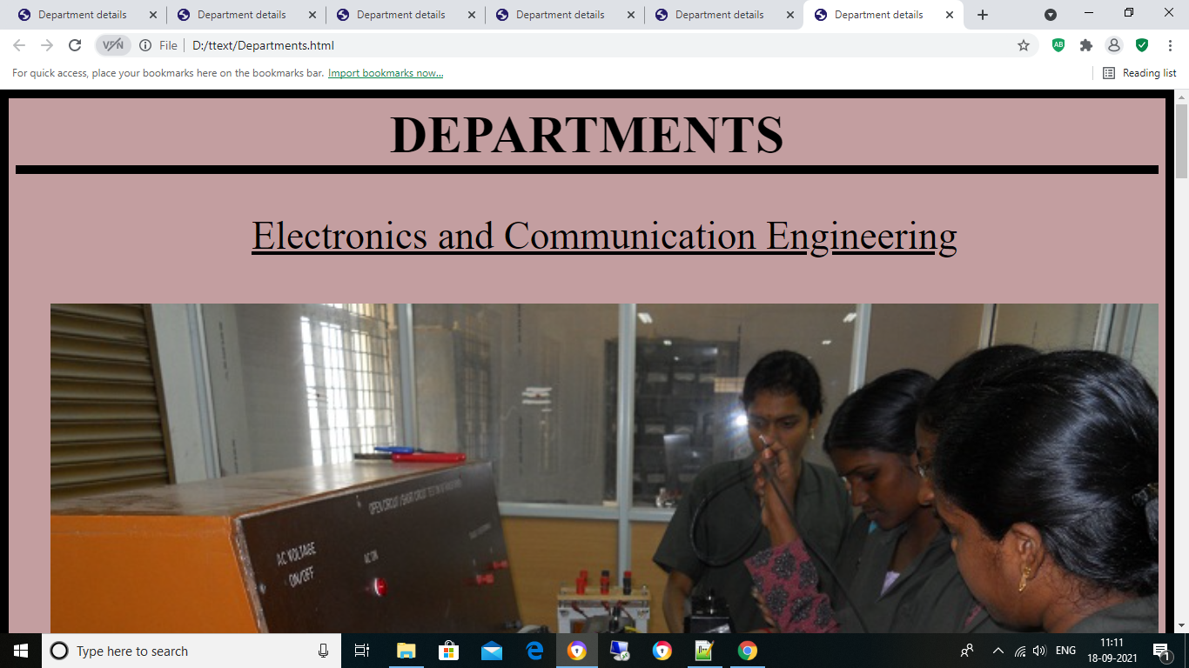

Slide 19
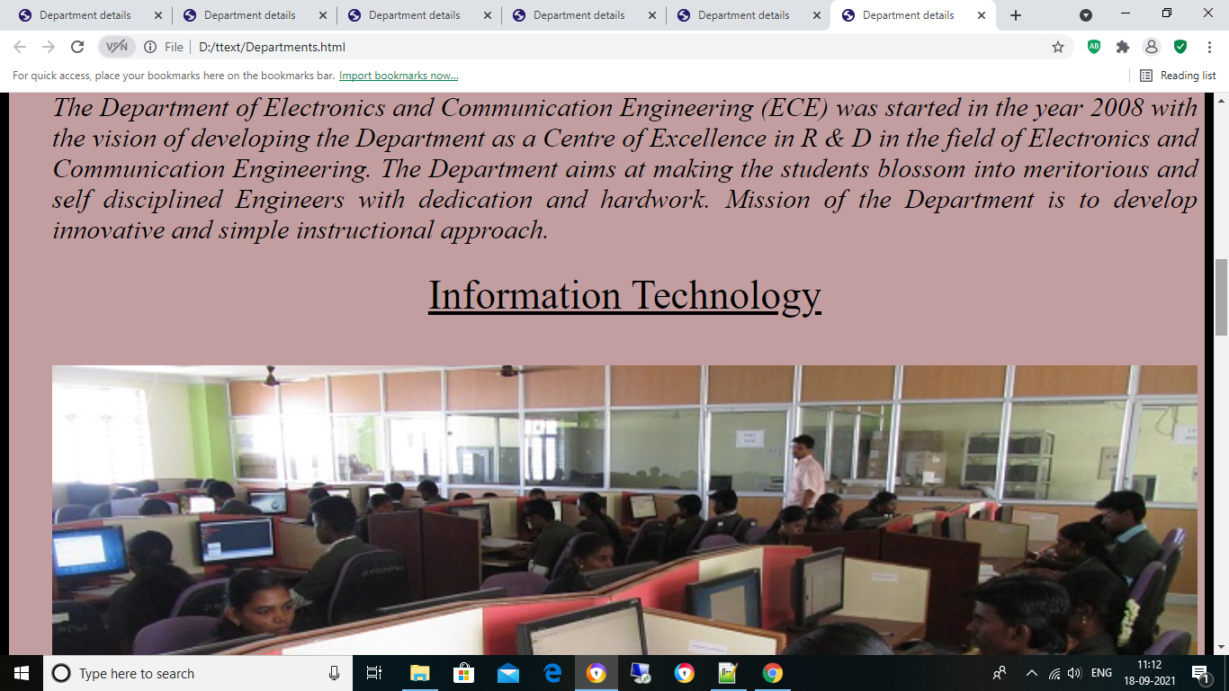

Slide 20
ADMISSION PAGE
Admission page is used to provide support to the administration and admission seeking candidates by providing a faster, transparent ,and easy way of maintaining records and utilize them for reference and further proceedings. And its also save time.

Slide 21
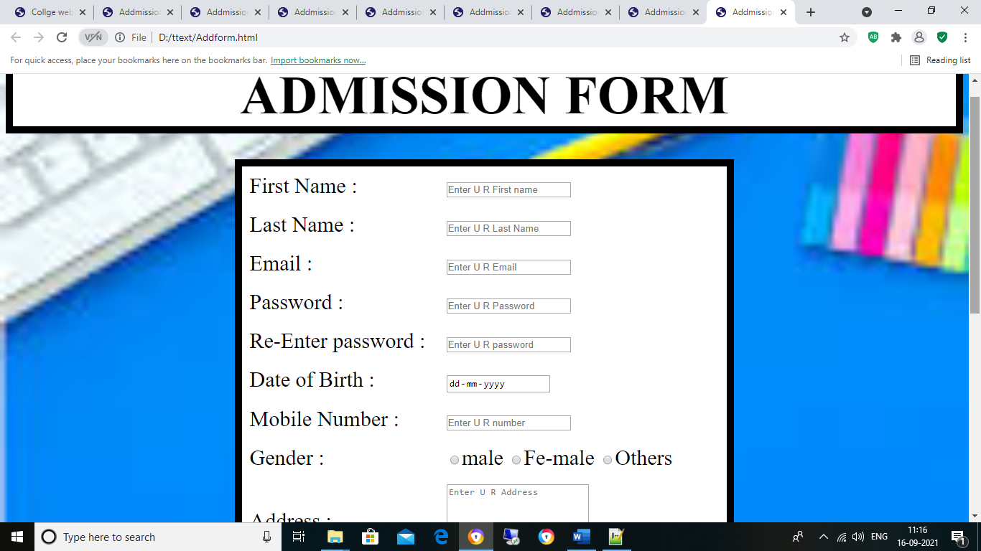

Slide 22
IMAGE GALLERY
The first and most obvious purpose of including a image gallery to in websites is displaying the colleges Structure and services. Adding an image gallery in websites will not only make your page more attractive but will also engage your visitors and increase the time they spend on page.

Slide 23
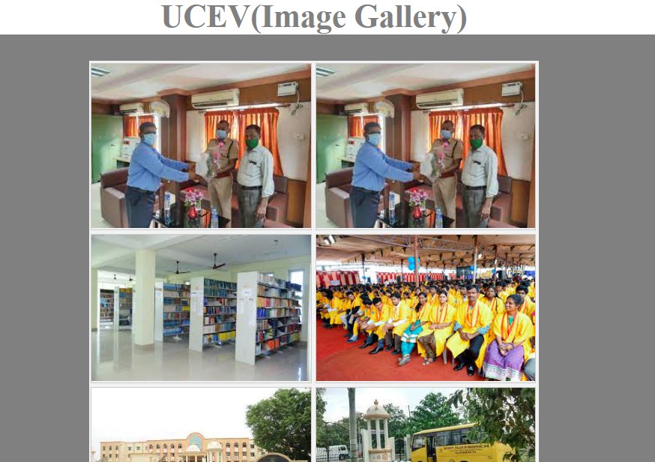

Slide 24
ADVANTAGES OF COLLEGE WEBSITE
Information Exchange
Advertising
Online presence
Increasing enrolment
Save time and easy enrolment process

Slide 25
CONCLUSION
Colleges also use their websites as a powerful tool for faculty and enrolment purpose . It is the base for communication between faculty and students. And it is used to provide timely, engaging, and current information to our students and also attract new students.

Slide 26
Thank You

